Slide 1
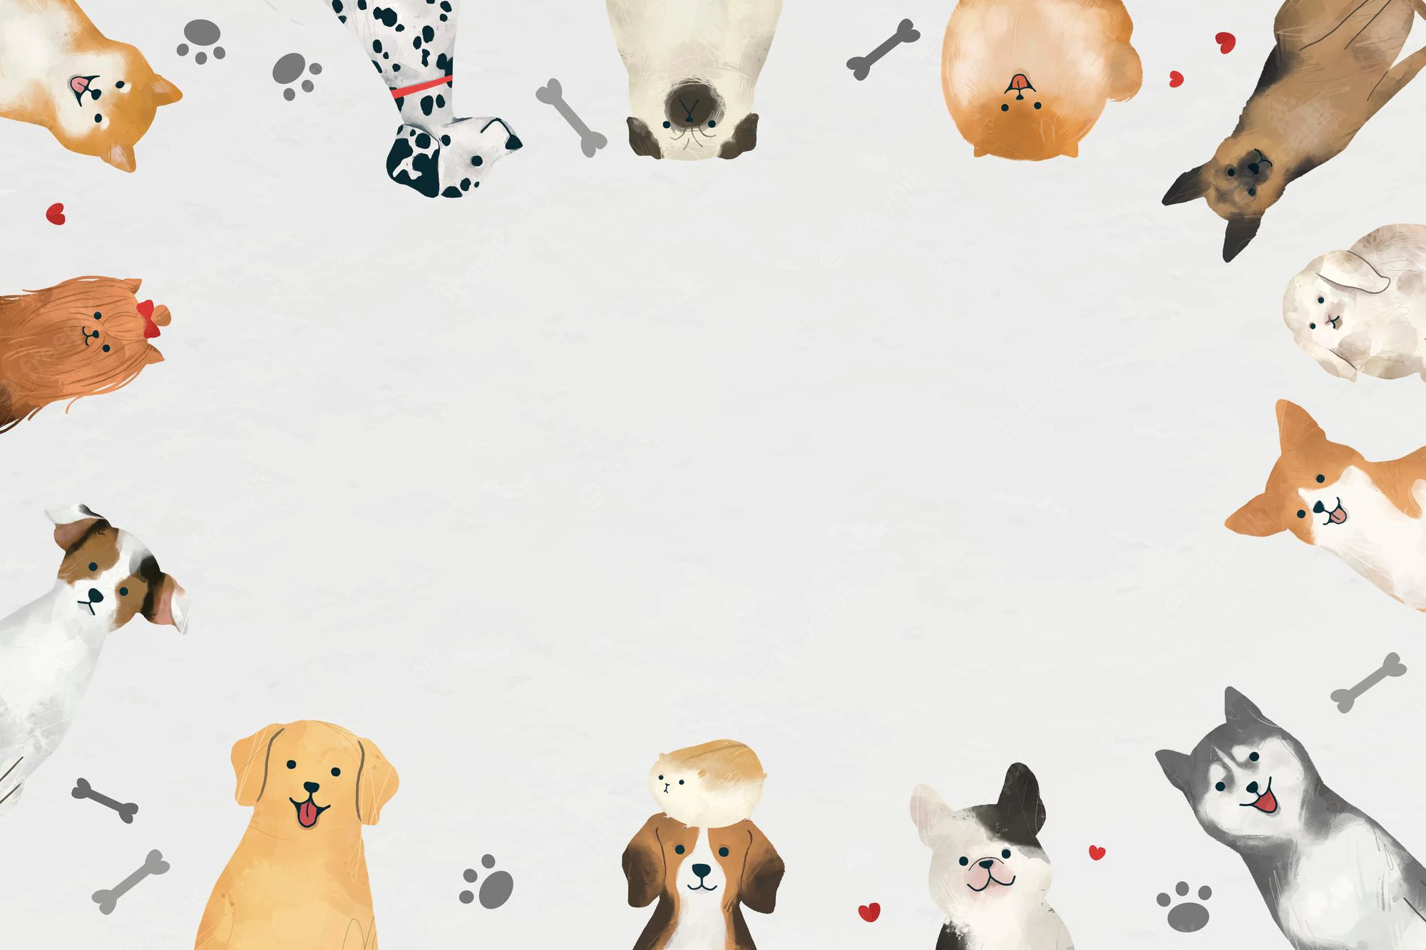
PetShop
IT Talents Season 14

Slide 2
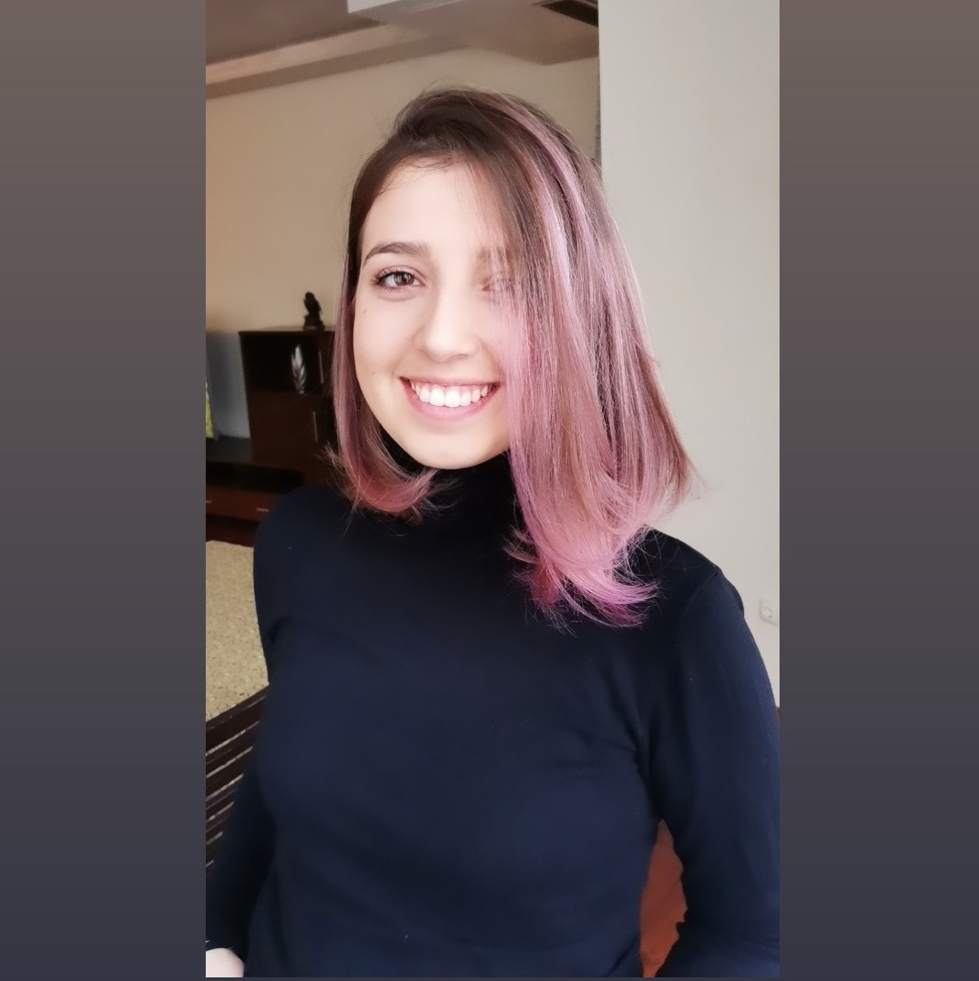
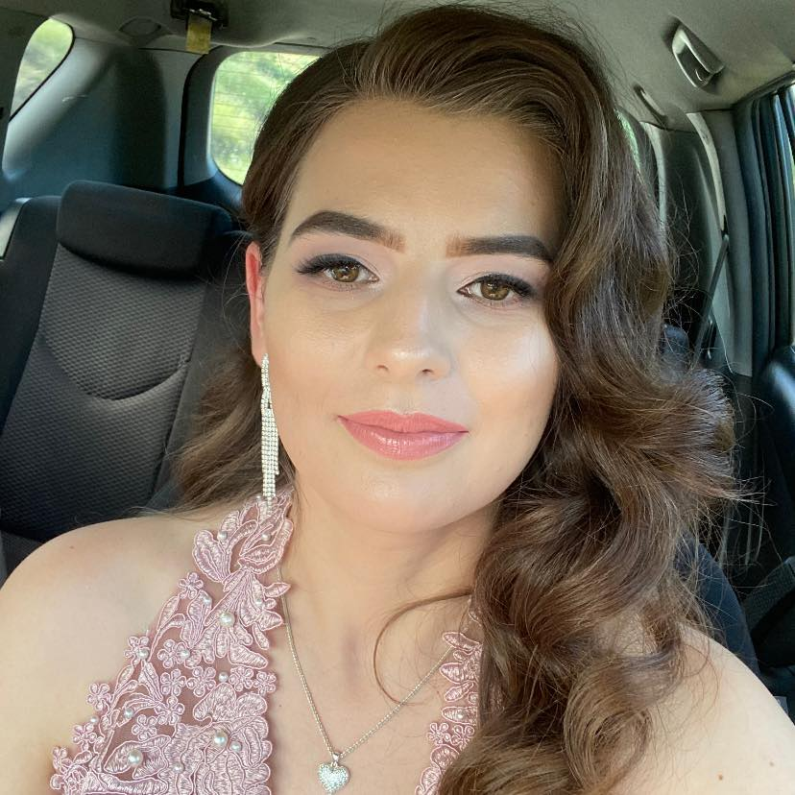
About us
Yuzden
Dari

Slide 3
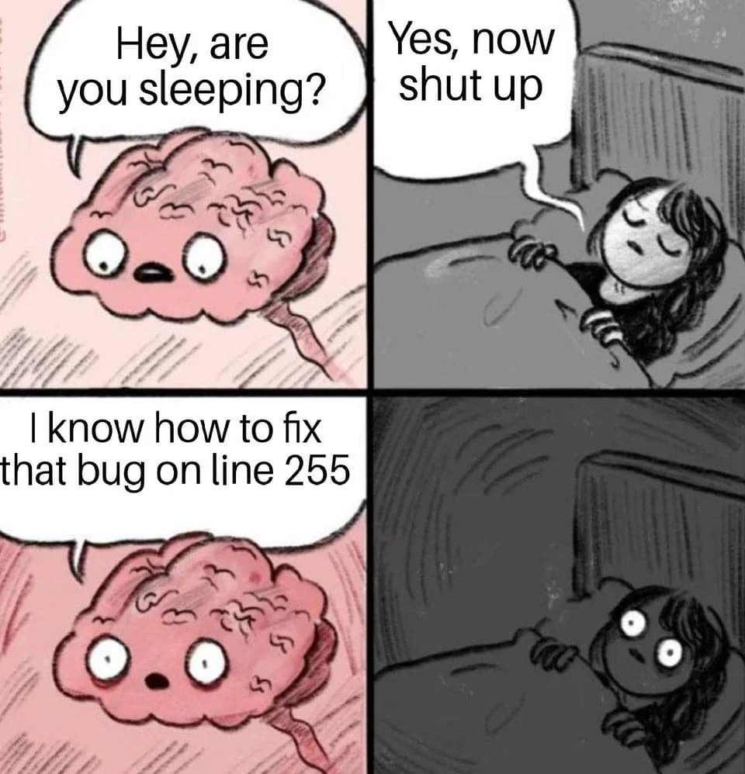
9 days, 2 people
3276 lines of code
90 java files

Slide 4
Functionalities (1)
User
Register/Login and Logout
Delete account
Subscribe/Unsubscribe
Add address
Add product to favorites
Show/Edit profile
Upload profile picture
Add/Show all orders

Slide 5
Functionalities (2)
Admin
Add/Delete category
Add/Delete subcategory
Add/Delete/Edit product
Add picture for product
Add discount and inform all subscribers via email

Slide 6











Technologies
Intellij IDEA
Java 17
Maven
Spring Boot
BCrypt
Lombok
Tomcat
Hibernete
Postman
Git
MySQL

Slide 7
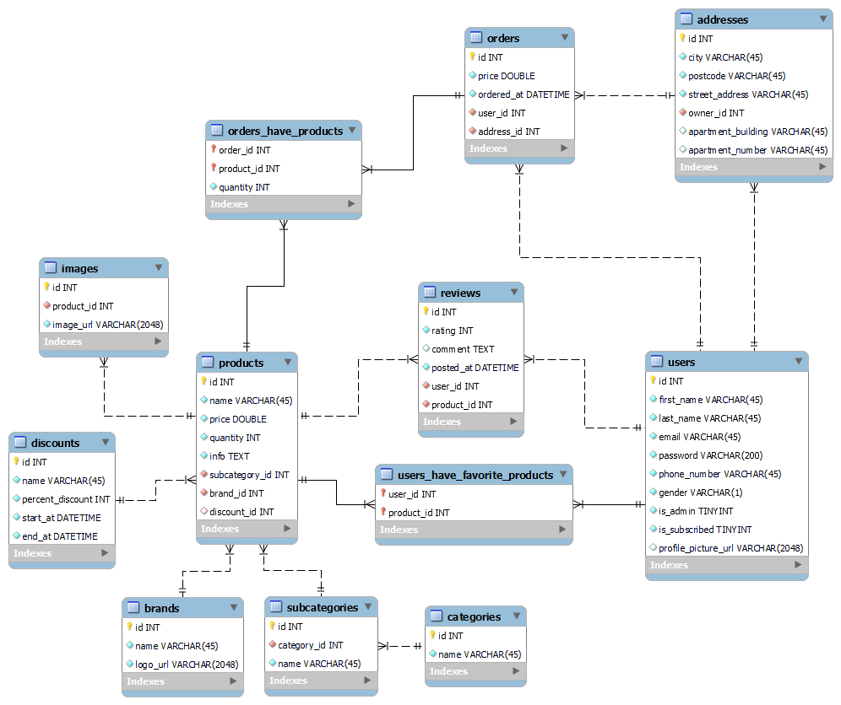
ER Diagram

Slide 8
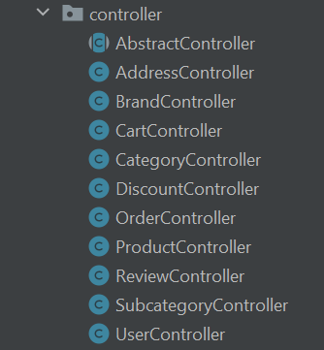
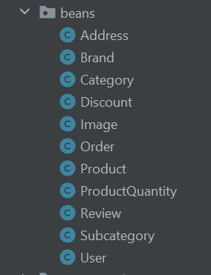
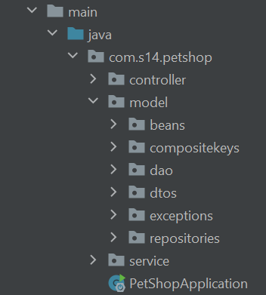
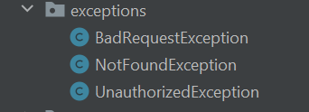
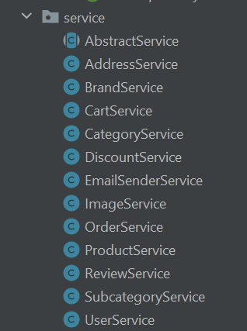
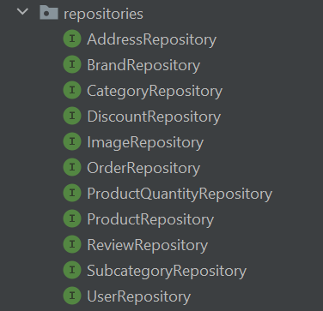
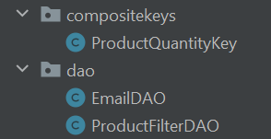

Slide 9

DEMO TIME

Slide 10
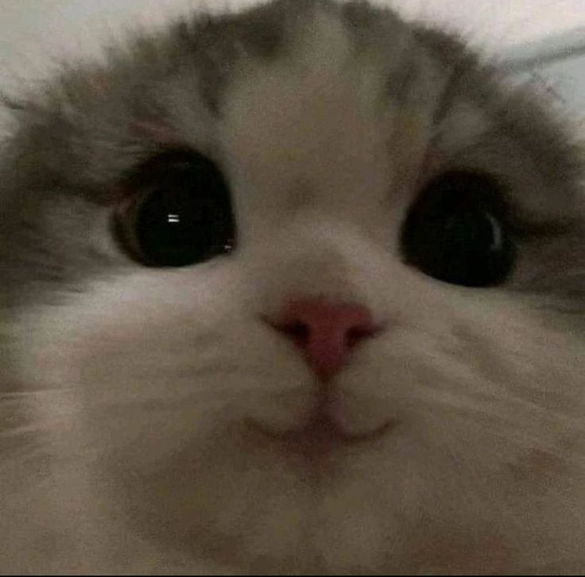
Thank you for your attention!

